Slide 1
Mobile Game Development
By Joshua Barnes

Slide 2
Initial idea
To develop a simulation game.
Farming game that follows some core mechanics similar to games like: Hay Day and Farmville.
The difference being that this game will involve mini games that take advantage of controls only mobile devices have.

Slide 3
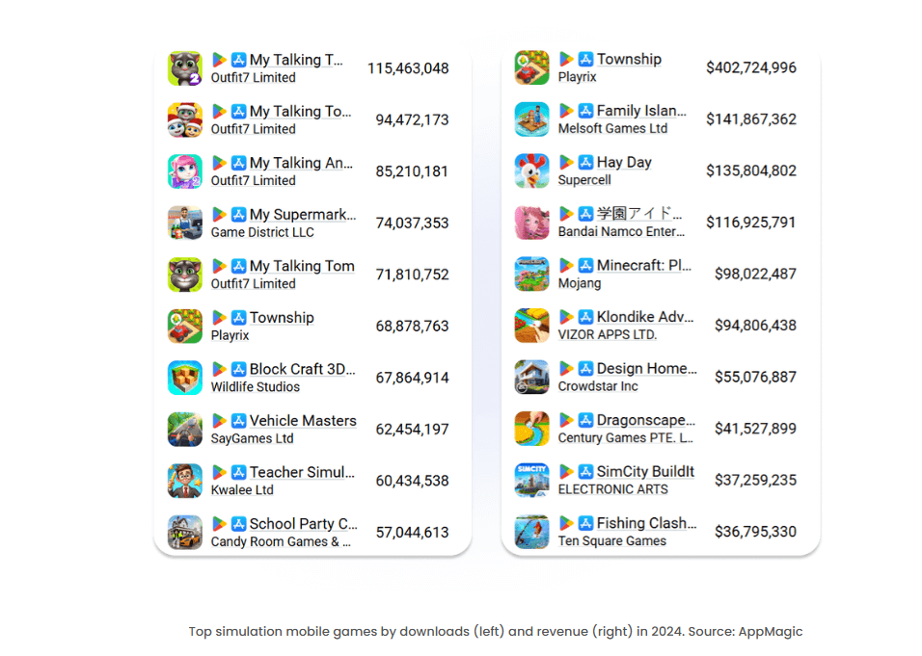
Why simulation?
The following image shows the downloads of simulation games and the revenue made.
200+ Mobile Gaming Market Statistics [2025 Report] shows that simulation and puzzle were the most downloaded mobile game genres
The difference which intends to make this game stand out is using unique features contained only on mobile devices.

Slide 4
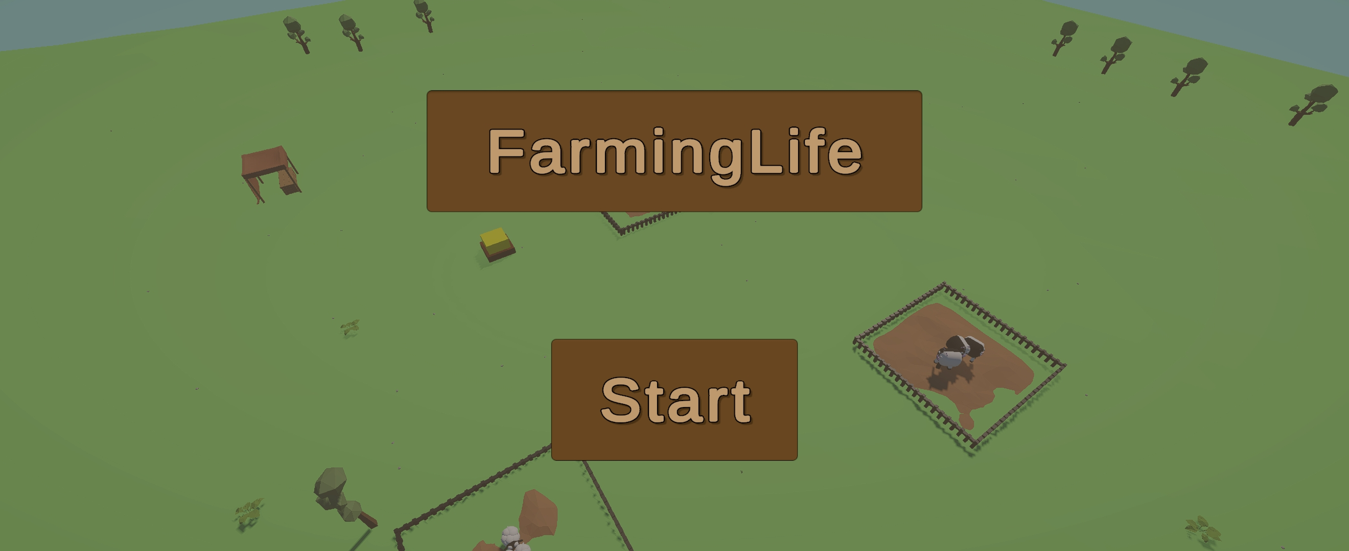
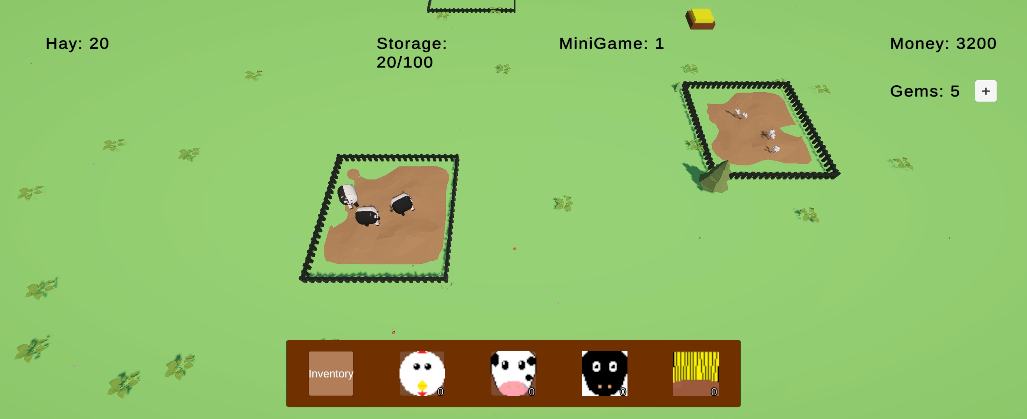
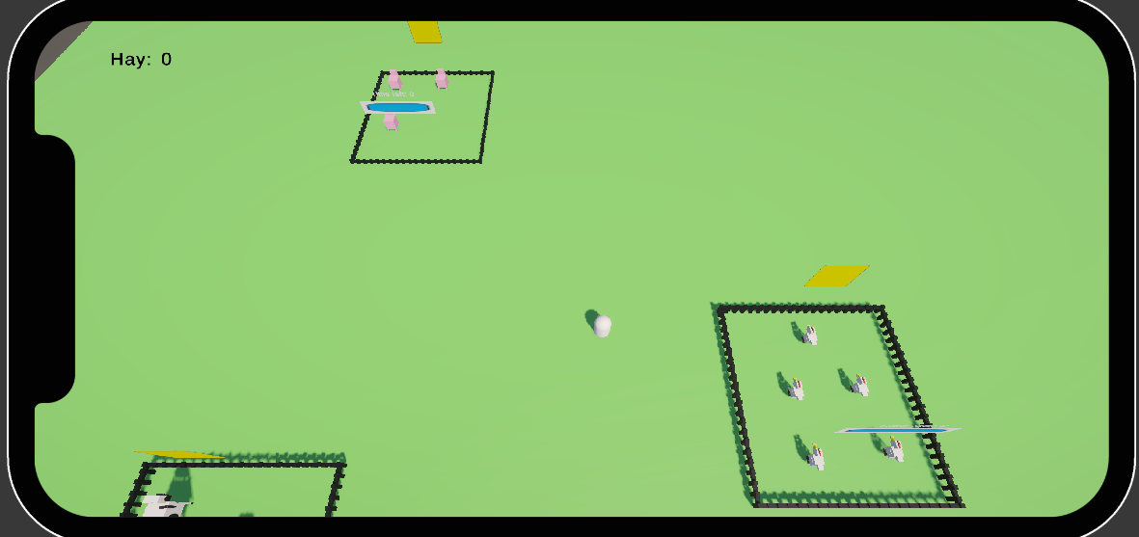
Core Features
Game involves building your own farm.
Farm will include animal pens and crops which can be harvested after a certain amount of time.
Farmers will act as helpers to help maintain the farm such as cleaning and gathering.
Buying and selling systems in place to provide currency.
Currency used to purchase more on the farm.

Slide 5
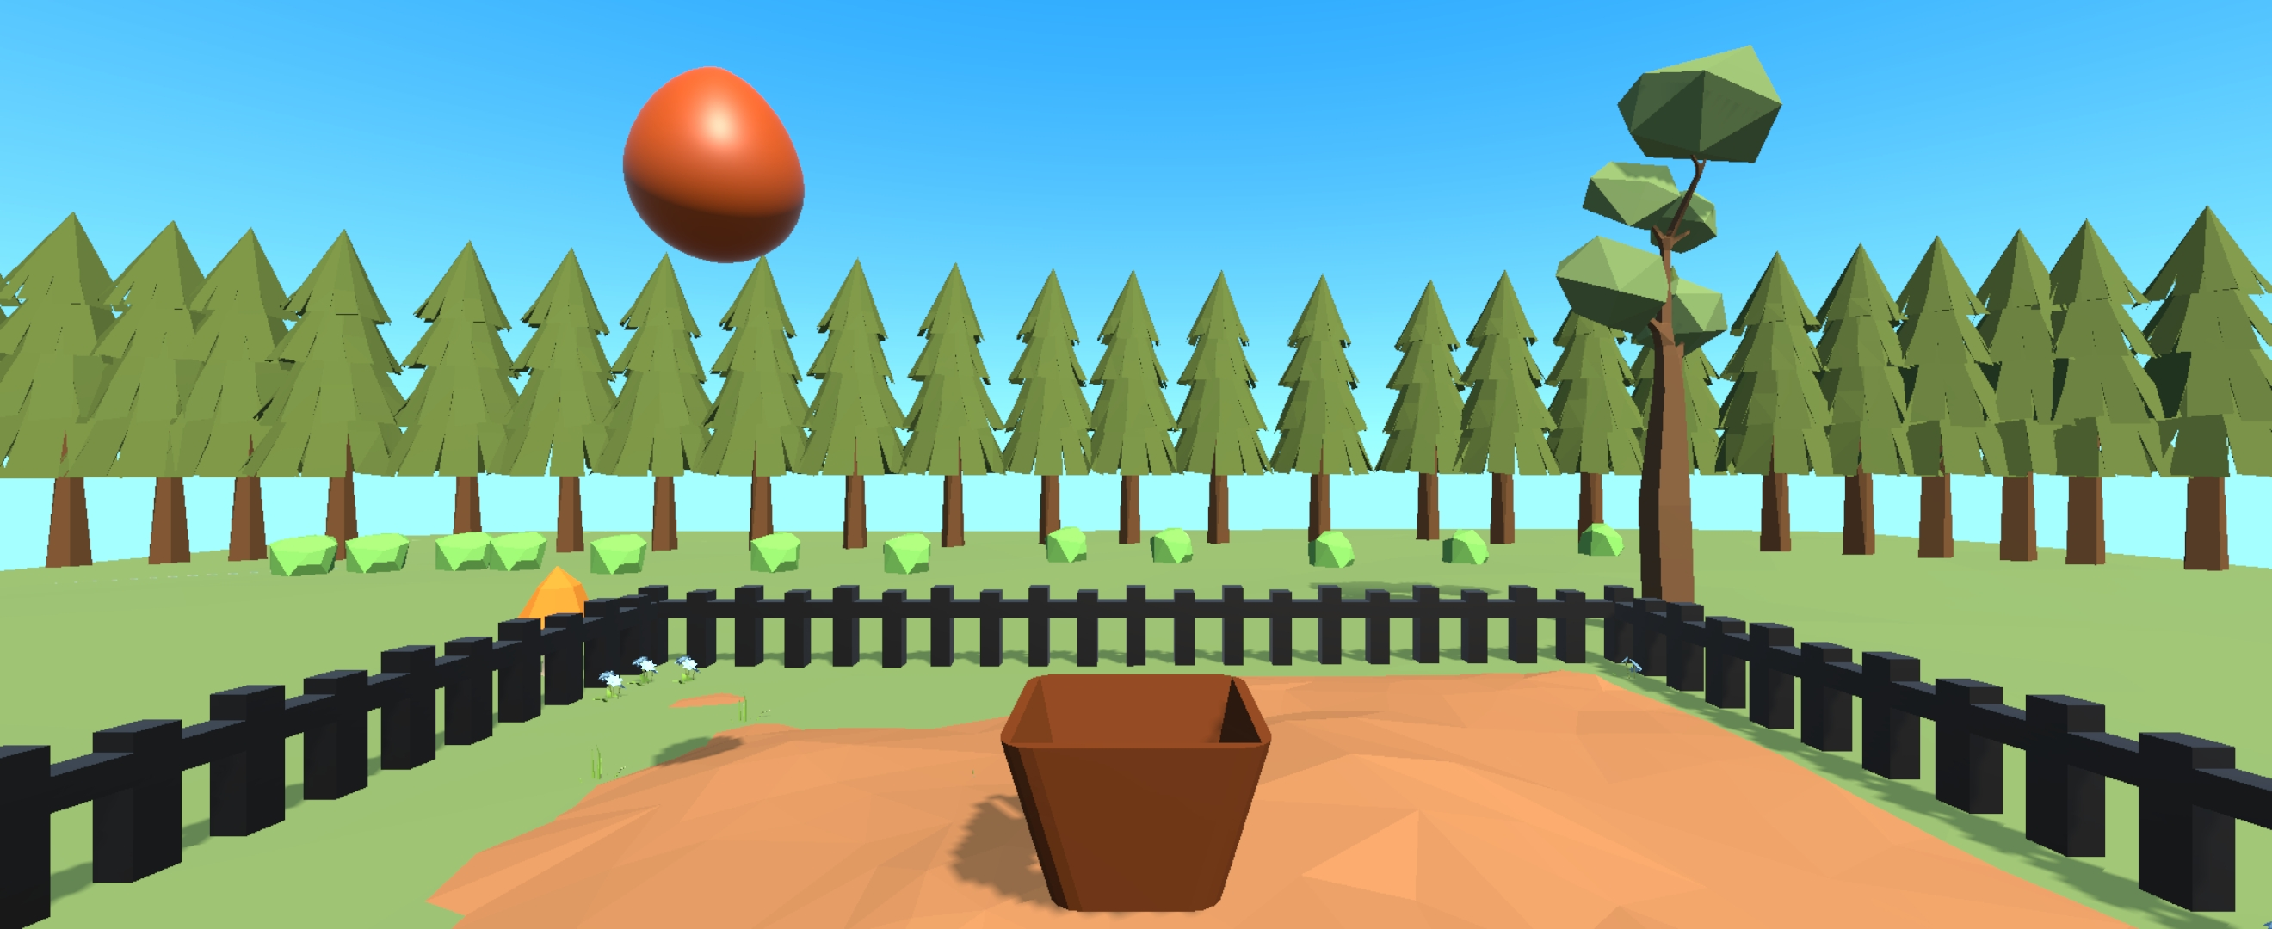
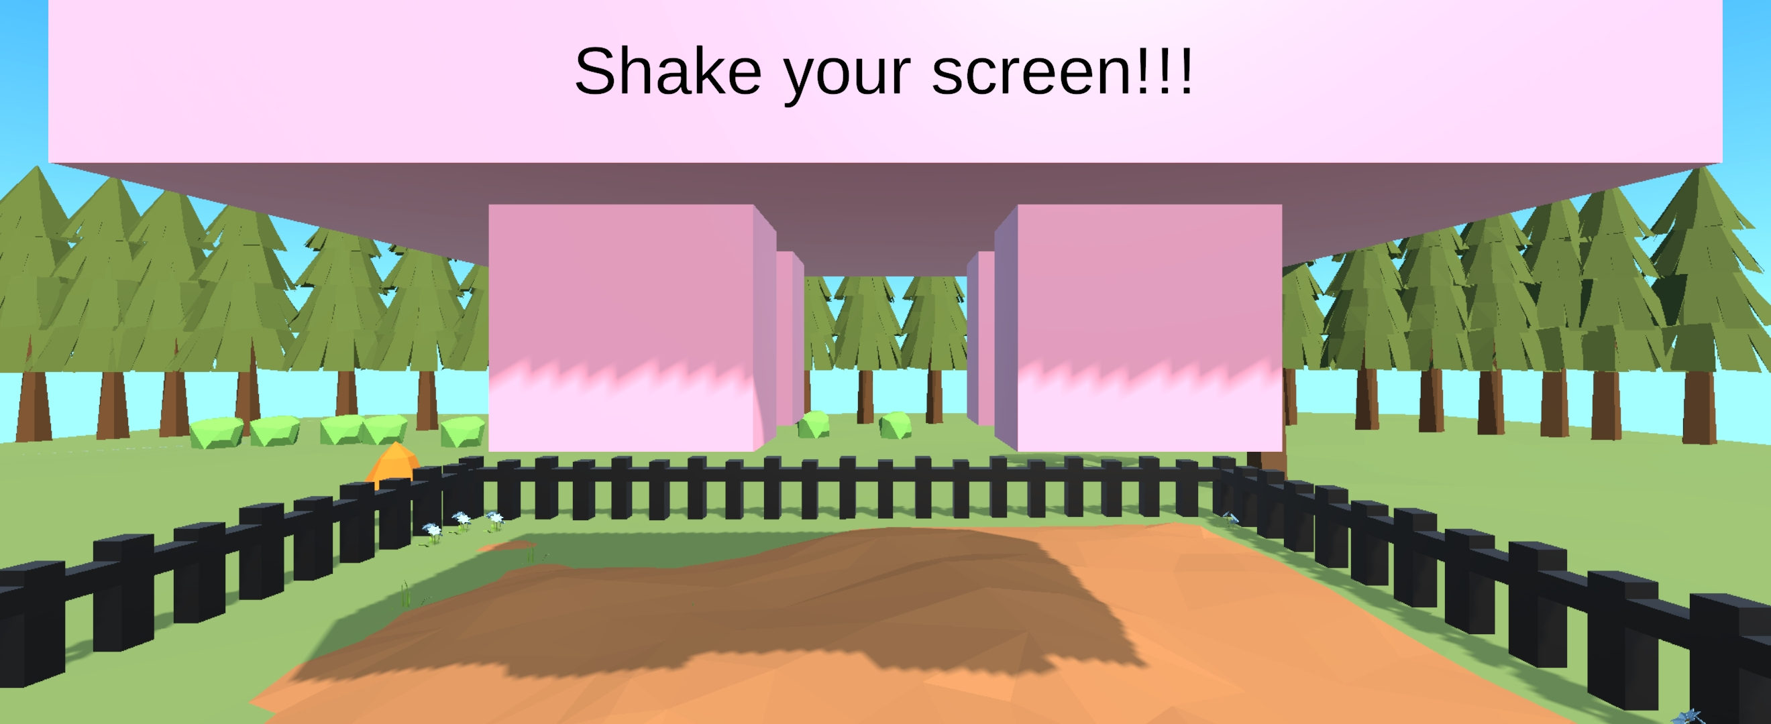
Phone Sensors
Accelerometer used for the cow minigame whereby you must shake the phone to milk the cow.
Gyro is used for the chicken minigame whereby the player tilts the basket to catch the eggs
Microphone is used for the sheep minigame whereby the player blows into the mic to strip the wool.

Slide 6
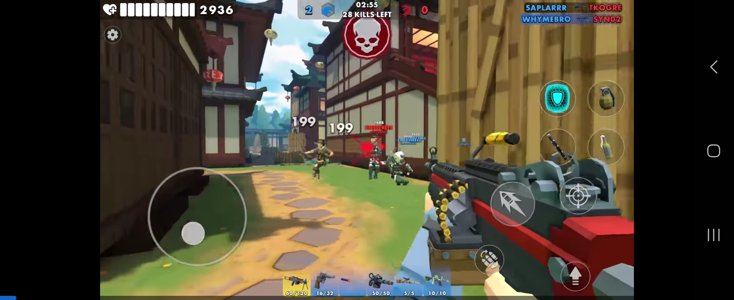
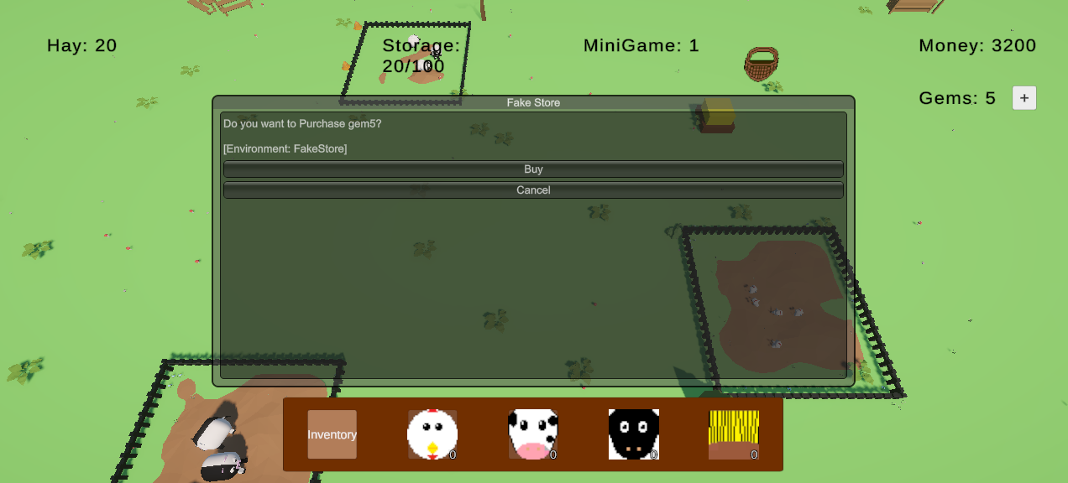
Frameworks used
The game uses unity ads within the game.
Banner ads in inventory
Rewarded ads for minigame tokens
Interstitial ads for collecting items
Microtransactions have been added to the game.
Purchase premium currency (consumable)
Purchase no ads option (non-consumable)
Third party vibrations
When completing a minigame there is a long vibration
Collecting items result in a short vibration
Buying new pens results in a short burst of vibrations

Slide 7
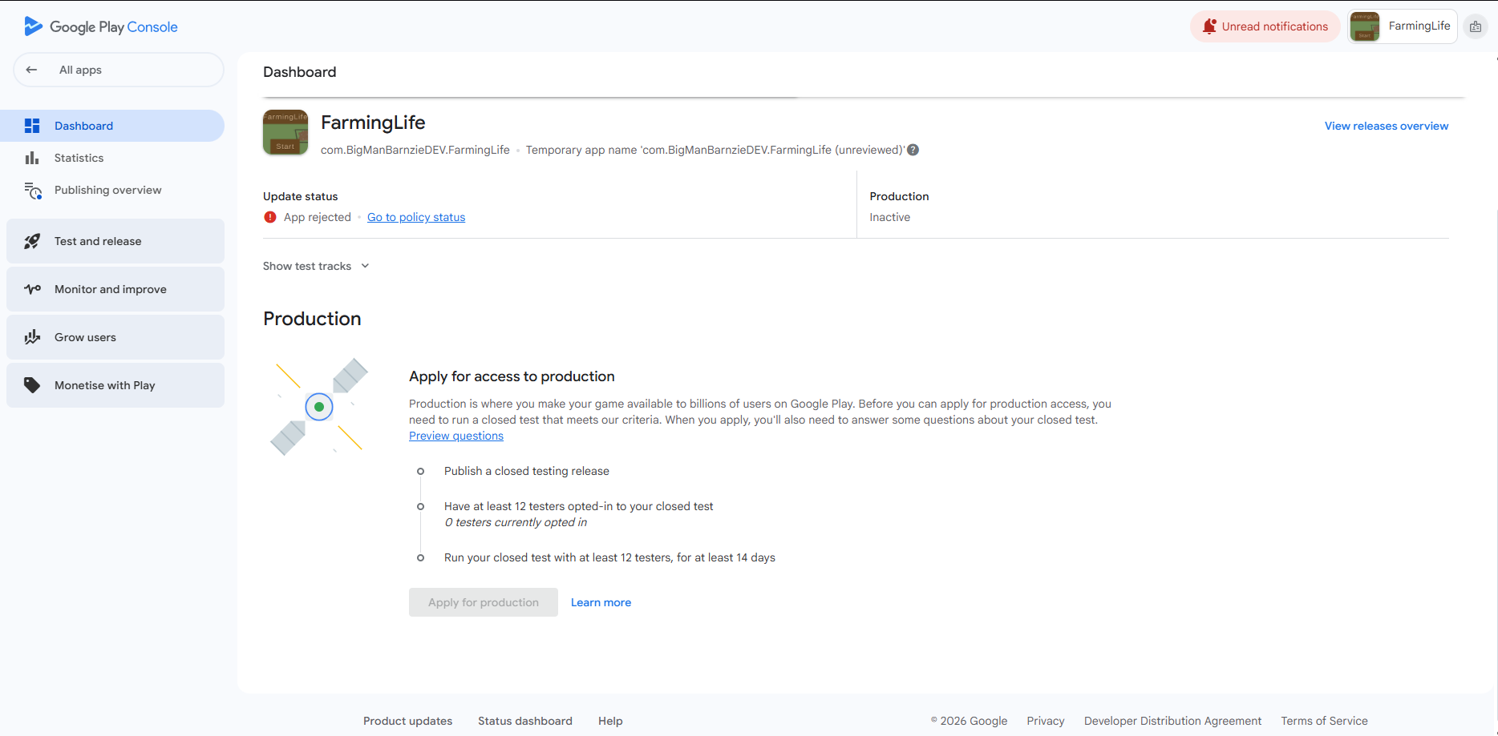
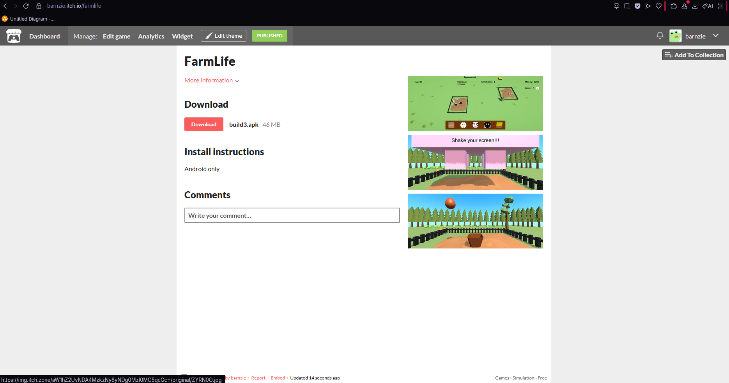
Publication
Itch.io the game has been published on this platform
The game is within the testing phase on the google play console
Project available on github.

